Slide 1
Methods 2 Classroom 4

Slide 2
TODAY
Math basics: functions, equations, polynomials, logarithms (high school repetition before the coming weeks)
I can guide the first exercises
Feel free to not follow along – and ask Chris for help if I am unavailable
Remember to keep asking if you are stuck ☺
Link to exercises: https://classroom.github.com/a/L12rNEva

Slide 3
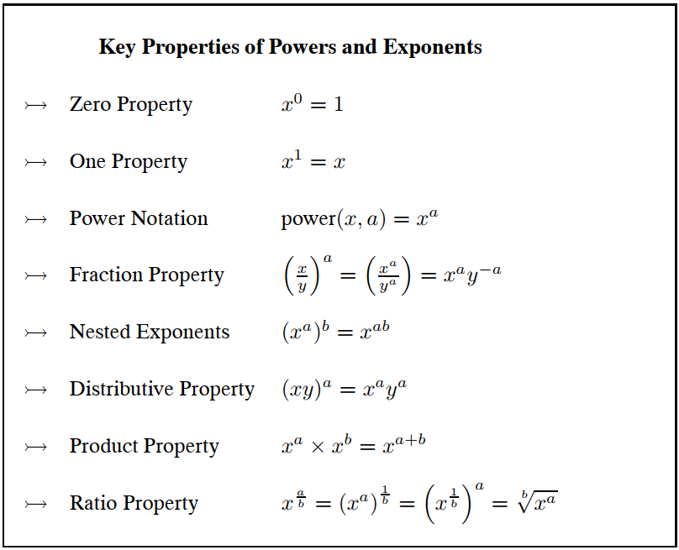
Important Properties

Slide 4
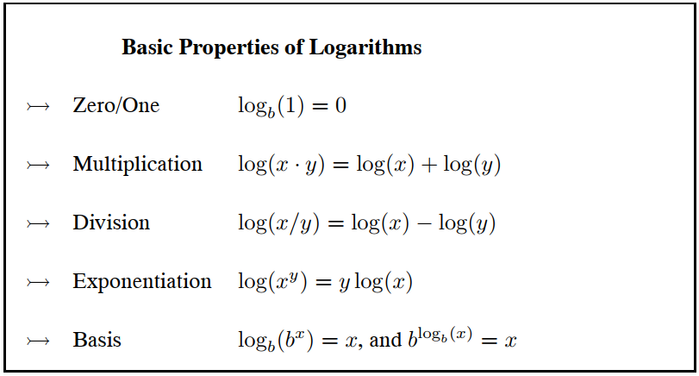
Important Properties

Slide 5
Inequalities
You can add the same quantity to each side
You can subtract the same quantity from each side
You can multiply or divide each side by the same positive quantity If you multiply or divide each side by a negative quantity, the inequality symbol must be reversed.

Slide 6
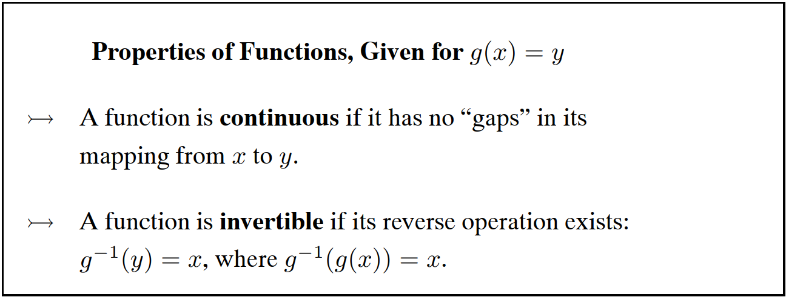
Continuity

Slide 7
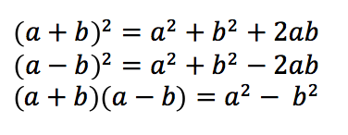
biNOMIAL sQUARE

